Slide 1
Patient Activation
Emily Balmer
ebalmer@carecompassnetwork.org

Slide 2
The Project -
Implementation of Patient Activation Activities to
Engage, Educate, and Integrate the uninsured and low/non-utilizing Medicaid populations into Community Based Care
Notes:
Project Description
Project 2di, or Patient Activation, is all about wrapping healthcare services around the individual and providing guidance that is “best fit”. The PAM® survey is an important component because it assesses where the individual is at – in order for us to meet them where they are at, knowing where that is is an important first step.

Slide 3
DSRIP Requirements
For the purposes of the Delivery System Reform Payment (DSRIP) program, the Department of Health requires that the uninsured, non-utilizers, and low-utilizers exclusively be counted for the Patient Activation project.
Notes:
For the purposes of DSRIP, this project targets the uninsured as well as the non-utilizing and low-utilizing Medicaid members. The reason being that these individuals might be most at-risk for avoidable hospital admissions and ER use. The idea is that tailoring services to these individuals can significantly increase the effectiveness of the DSRIP program.

Slide 4
The Eligible Population
The Uninsured
Any individual not having health insurance
The Non-Utilizer
A Medicaid Beneficiary having no claims for qualifying services
The Low-Utilizer
A Medicaid Beneficiary having less than 3 claims for qualifying services
A Medicaid Beneficiary exclusively visiting the hospital, the eye doctor, or the dentist (rather than visiting their primary care physician)
Notes:
The New York State Department of Health has released some definitions of what this target population is which are summarized as follows…
While there are many other qualifications and exceptions, Care Compass Network has aimed to identify these individuals mentioned in order to increase the feasibility of this project.

Slide 5
Screening
In order to ensure the target population is reached, a tool was developed to determine whether or not an individual is eligible for the PAM® survey as per DSRIP requirements.
Notes:
In order to identify these individuals, a screening tool has been developed so that partners can become comfortable attesting that they have done their due diligence in ensuring this project has been administered to the individuals intended.

Slide 6
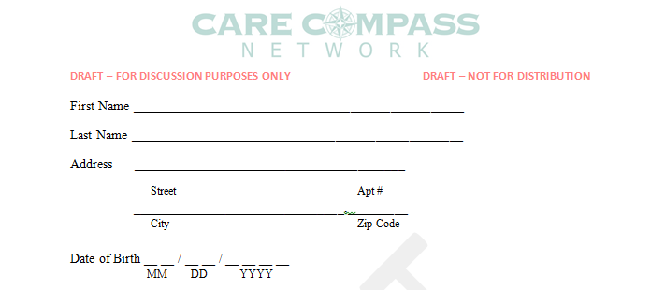
Flourish® Data
Includes Flourish® fields
Aids in the creation of unique identifier for the uninsured
Notes:
As we know, the Flourish® database requires certain fields be obtained. For the uninsured, these aid in the creation of a unique identifier. While a Medicaid beneficiary will have a different unique identifier, this information is helpful in terms of populating the Flourish® database and allows for the screening tool to be structured most logically.

Slide 7
Unique Identifier – The Uninsured
The Unique Identifier for the Uninsured must be manually generated using:
Date of Birth
First 2 letters of first name
First 1 letter of last name
Last 3 numbers in zip code
For example, for John Doe living in a 13901 zip code with a 01/01/1982 DOB, the unique identifier created would be “19820101JOD901” using birth year, birth month and date, first 2 letters of the first name, first letter of the last name, and last 3 numbers of the zip.
Notes:
Walk through some examples…

Slide 8
Screening Tool – Q1
If “no”, the individual does not have health insurance and should proceed to take the PAM®…
Notes:
Again, our goal for this project is to locate the uninsured, and the non-utilizing and low-utilizing Medicaid beneficiaries. Question 1 identifies immediately whether or not an individual falls into the uninsured category.

Slide 9
Screening Tool – Q2
If the individual does not belong in the uninsured category, establish Medicaid status.
Not enough information to direct the individual to take the PAM®.
Notes:
Again, our goal for this project is to locate the uninsured, and the non-utilizing and low-utilizing Medicaid beneficiaries. While the uninsured have been identified in the first question, the next step is to determine whether or not the individual is a Medicaid recipient. This question helps the beneficiary determine this by also listing the most common Managed Care Organizations. A supplemental guidance document including pictures of these cards and where the CIN# is located is included in the materials provided in order to assist the survey administrator. It is important to note that there are plans not covered by the guidance document or Question 2. If you are located nearby a college campus where many students are from downstate, it may be useful to familiarize yourself with some non-local Medicaid options. If an individual is not prompted to stop at this question, they must proceed to the next question in order to determine eligibility for the PAM®.

Slide 10
Screening Tool – Q3
If the individual is a Medicaid beneficiary, utilization must be determined next.
If the individual answers “0”, they are a non-utilizer and should proceed to take the PAM®.
If the individual answers “1-2”, they are a low-utilizer and should proceed to take the PAM®.
If the individual answers “More than 2”, we have one more question for them.
Notes:
Question 3 establishes non-utilizers and low-utilizers by their most basic definition. Without having to ask too many questions, if it can be determined that an individual has not seen a doctor or really, has had fewer than 3 claims in the last 12 months, they are determined to be low (1-2) or non (0) utilizers.

Slide 11
Screening Tool – Q4
As long as the individual does not check, “Doctor’s Office”, they should proceed to take the PAM®.
It is important to note that you may be prompted to explain these options. For example, “hospital” is not an option. Inpatient services would allow for an individual to qualify as low-utilizing but seeing a primary care doctor or a specialist located within a hospital building should be considered a doctor’s office.
Notes:
Question 4 targets a very specific subset of the eligible population for the PAM® survey. If an individual exclusively uses dental care, eye care, or the emergency room / hospital, they are considered to be low-utilizing beneficiaries.

Slide 12
Other Important Points…
Double check the screening tool.
Familiarize yourself with UI, NU, and LU definitions.
Notes:
Check the Screening Tool – Make sure that an individual has properly followed directions on the screening tool. You don’t want to glance quickly at Question 4 to see it checked off favorably only to realize the individual should have stopped at Question 3.
Familiarize – In case an individual has some clarifying questions, be sure to understand the definitions of the uninsured, non-utilizers, and low-utilizers in order to appropriately guide the screening.

Slide 13
Questions and Answers

